Slide 1

Memoria Web
Team: The Cybernauts
Team Number: Group 12
Team Members: https://billthekid2000.github.io/Project-Group-12/#
Billy Revelo (Team Leader) - Brevelo2019@fau.Edu
Alvaro Angeles (scrum Master) - Alvaroangele2021@fau.Edu
Andrew Ulloa (Front/Back-end Developer) - Aulloa2017@fau.Edu
Eric Pomerantz (Front/Back-end Developer) - Epomerantz2021@fau.Edu
Shuaib Olanrewaju (Product Owner/Designer) - Solanrewaju2020@fau.Edu
Website URL:
Summer 2023

Slide 2

Purpose
Enables users to explore valuable historical webpages that highlight the early internet scene.
Navigate numerous forgotten historical documents, analyze changes made to outdated social media platforms, discover the deletion of obscure websites and blog posts, or compare current websites with their past iterations.
Preserve websites, posts, and digital content so that future generations can witness the early phases of the internet.

Slide 3

Motivation
A longing for previous websites that held content now gone or unretrievable, leaving no trace online.
Recollect past social media platforms such as YouTube or Twitter, which once possessed distinct features that are no longer found in today’s online environment.

Slide 4
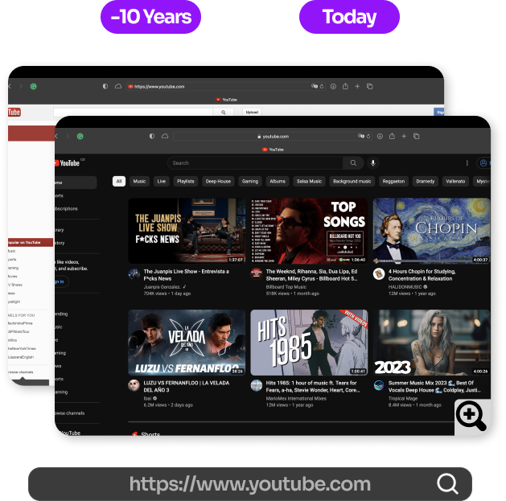
Functionalities
Explore different websites by inputting their corresponding URLs into the search bar.
Unlock past versions of the searched website from ten years ago. The Memoria Web will only show the cost of public domain access for websites less than ten years.
Conduct a side-by-side comparison of current and past versions of the websites to visually highlight the changes that have occurred over the years.

Slide 5
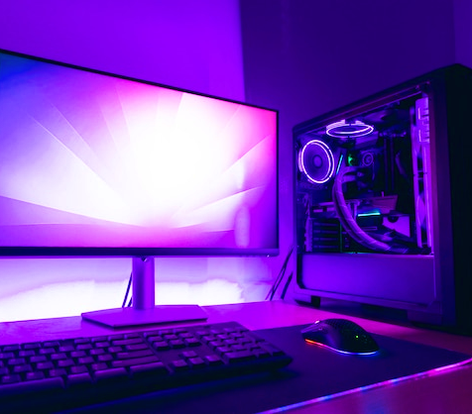
System Implementation Infrastructure
Languages: JavaScript, HTML, CSS
Database: Firebase
Library: JQuery, AJAX
Framework: Bootstrap 4.6
Platform: Google Chrome, Mozilla Firefox, Oracle Opera, Apple Safari

Slide 6

Target Audience
There is no "unique" target audience for our project, as it can be anybody who simply wishes to see a previous state of a given website.
A given audience who has a desire or nostalgia for seeing an old website's design.
Audiences of all ages and demographics are encouraged to utilize our website's functionality to its full potential.
Researchers and software engineers who wish to learn the beginning design structures of old websites.

Slide 7
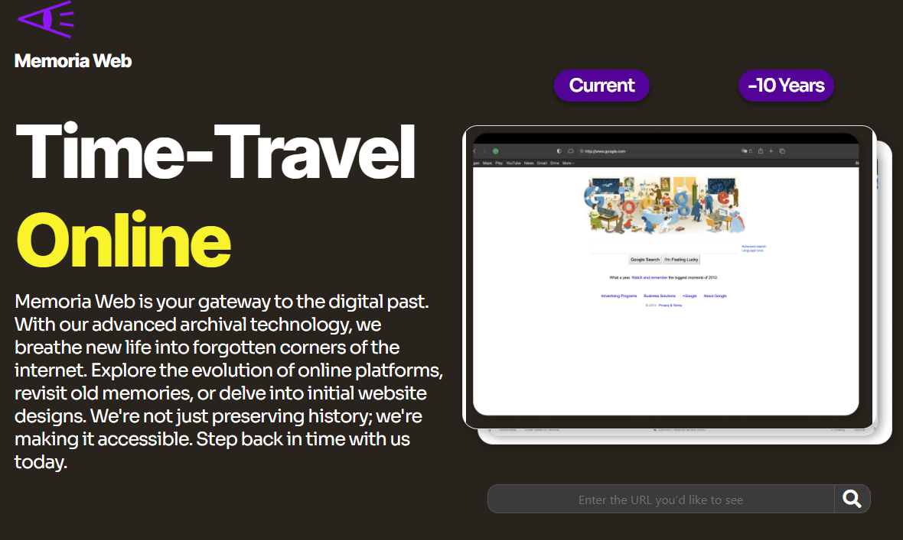
Functional Requirements
There is to be a title at the top of the main page stating, “Memoria Web,” with an active search bar for navigation to the various contents.
Our logo is to be present next to the main page title without any visual errors.
Underneath the main page, title should lay a concise description of the site’s overall goals.
It is necessary for the website to be short enough in height, guaranteeing that users do not have to scroll down to view all archived sites.
There should be at least 10 websites to monitor.
Each tracked site must state its name, date, and logo.
Every link to a tracked site must lead to said site in its past respective year.
At the bottom of the main page, there should be a copyright description and citations for the external services used for that site.

Slide 8
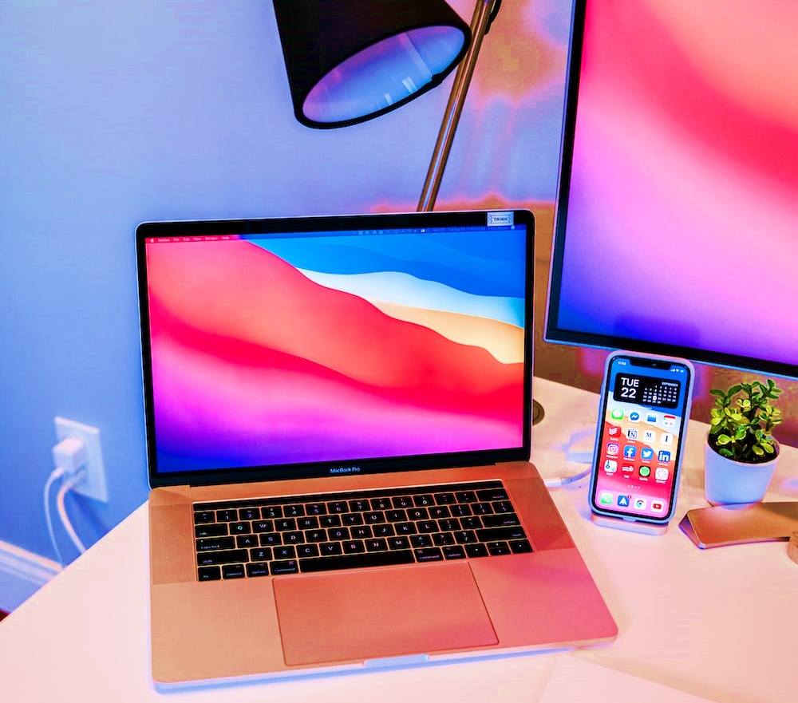
Non-Functional Requirements
The website must be easy to understand and acceptable for all types of users.
Site downtime must not exceed 10 minutes in total out of the 5 weekdays.
The site must be compatible with modern browsers such as Google Chrome, Mozilla Firefox, Oracle Opera, and Apple Safari.
Total website and project size must not exceed 5 gigabytes (5GB).
Response timing on user clicks and its reaction must not exceed 1 second.
The programming languages must include HTML, CSS, and Bootstrap programming.

Slide 9
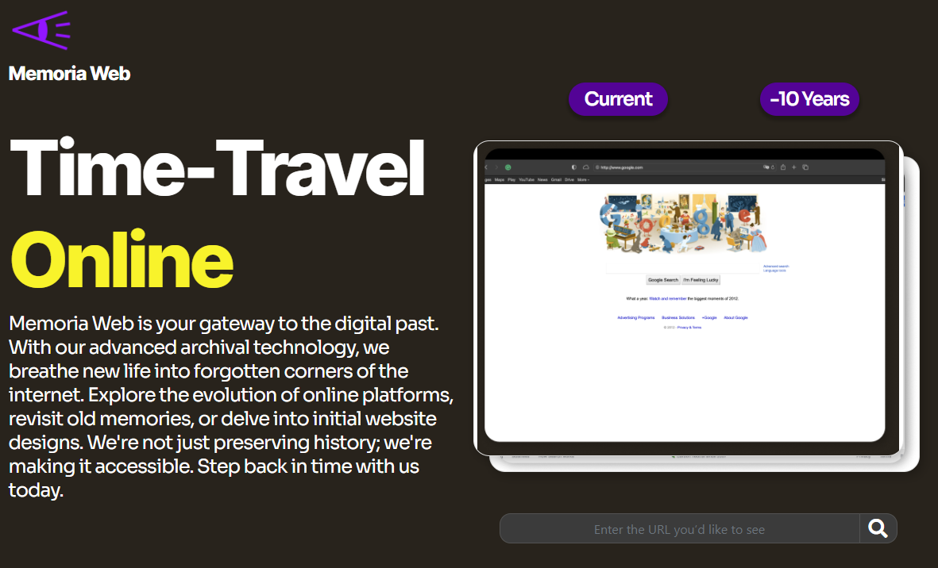
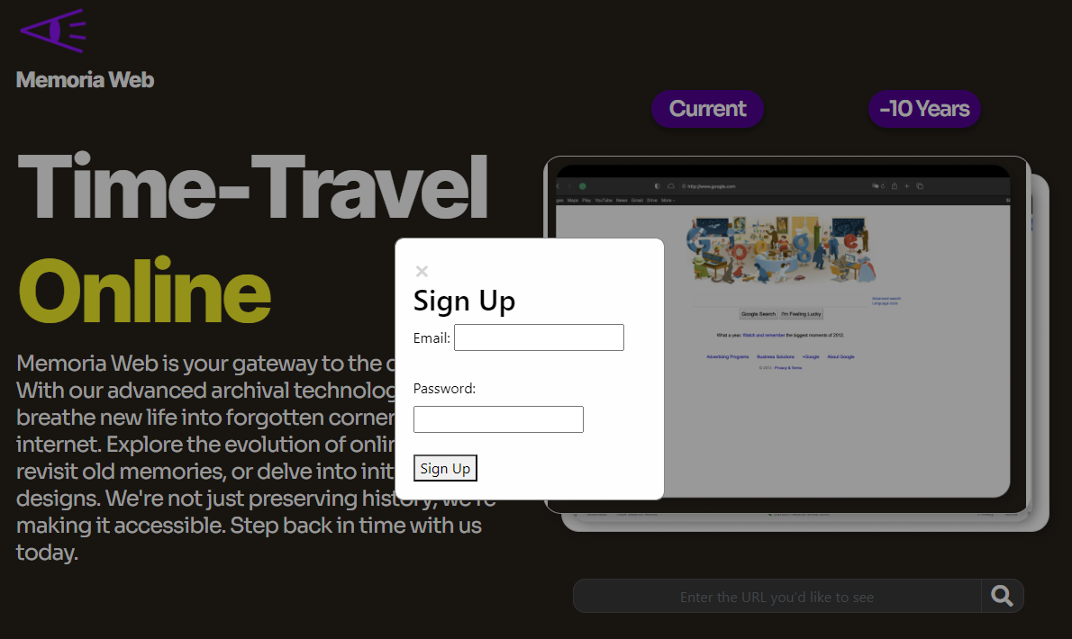
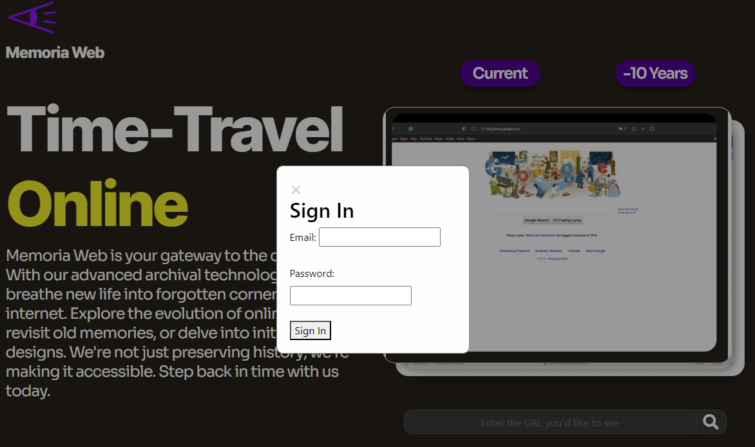
Main Screenshots of the Website's Functions
The main features of the main page were implemented.
Benefits, recent websites, and FAQs.
The custom search option is employed.
Sign-in and Sign-up options implemented for user accounts.
Access the Current and Past search options by clicking.

Slide 10
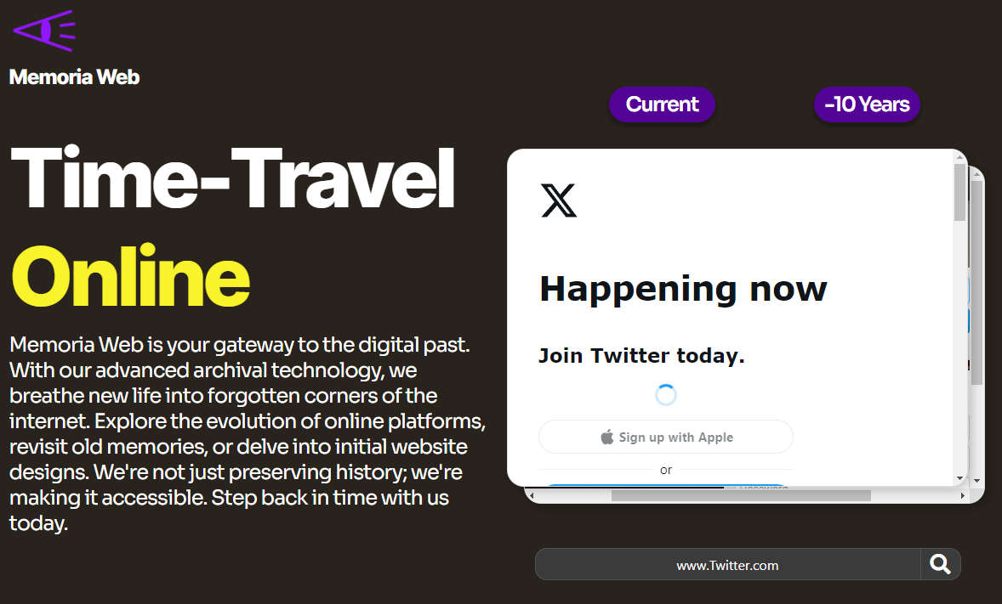
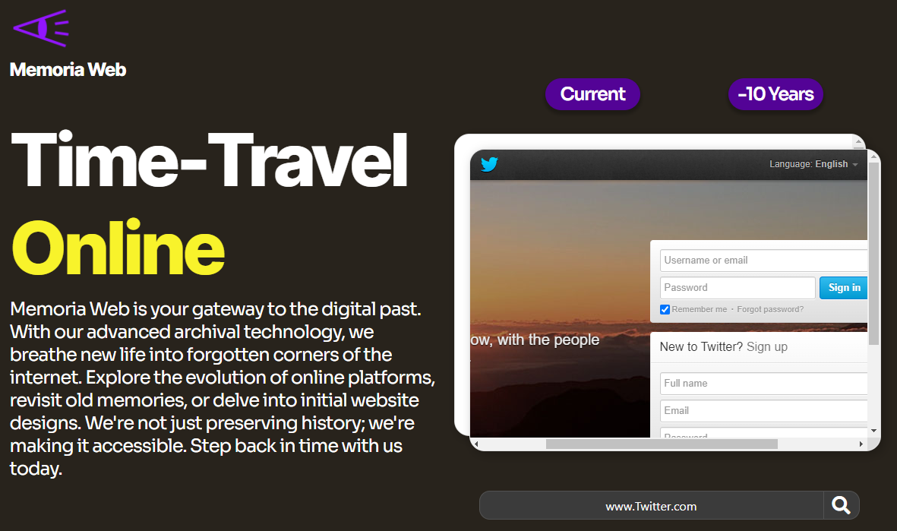
Main Screenshots of the Website's Functions (Cont.)​
Search Output (Current)
Search Output (Past)

Slide 11
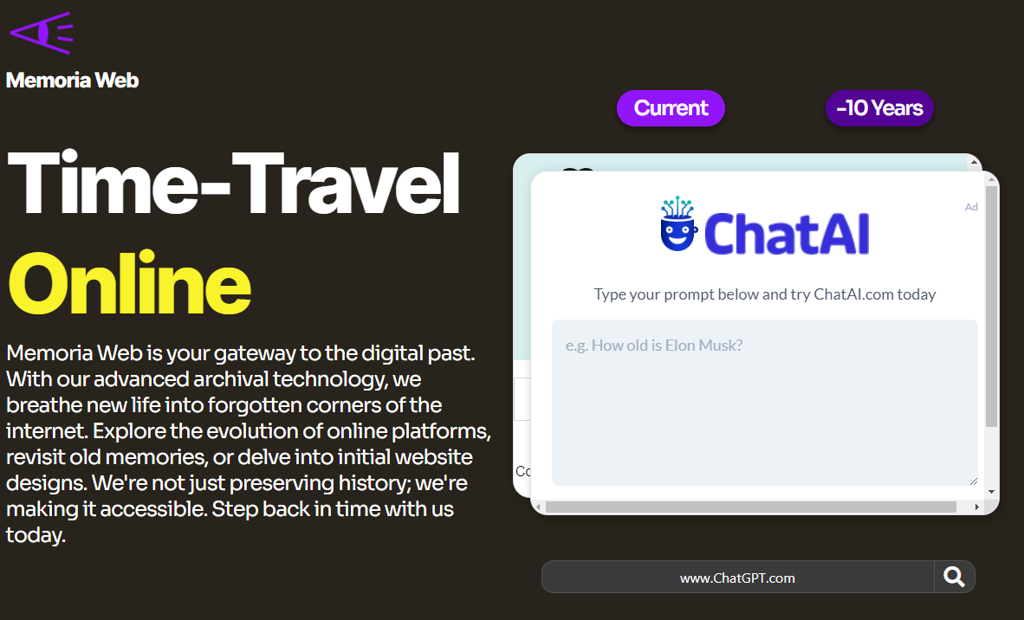
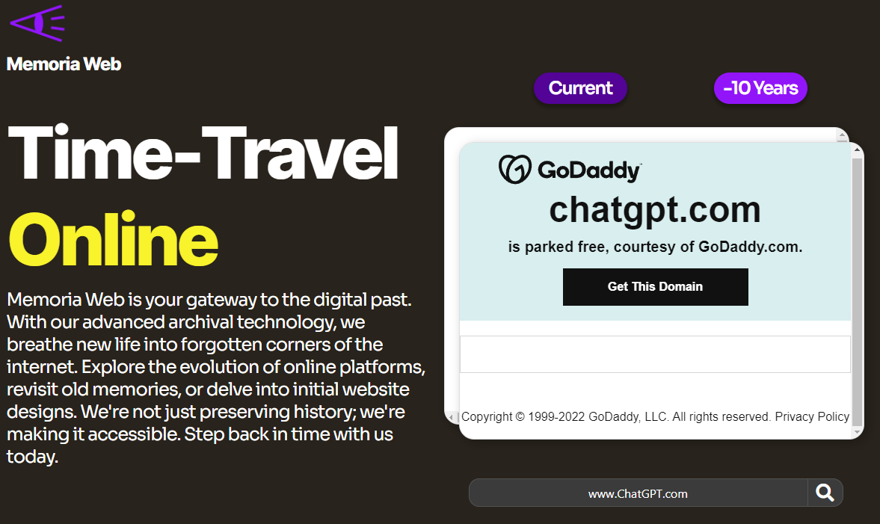
Main Screenshots of the Website's Functions (Cont.)
Search Output (Current)
Search Output (Past)

Slide 12
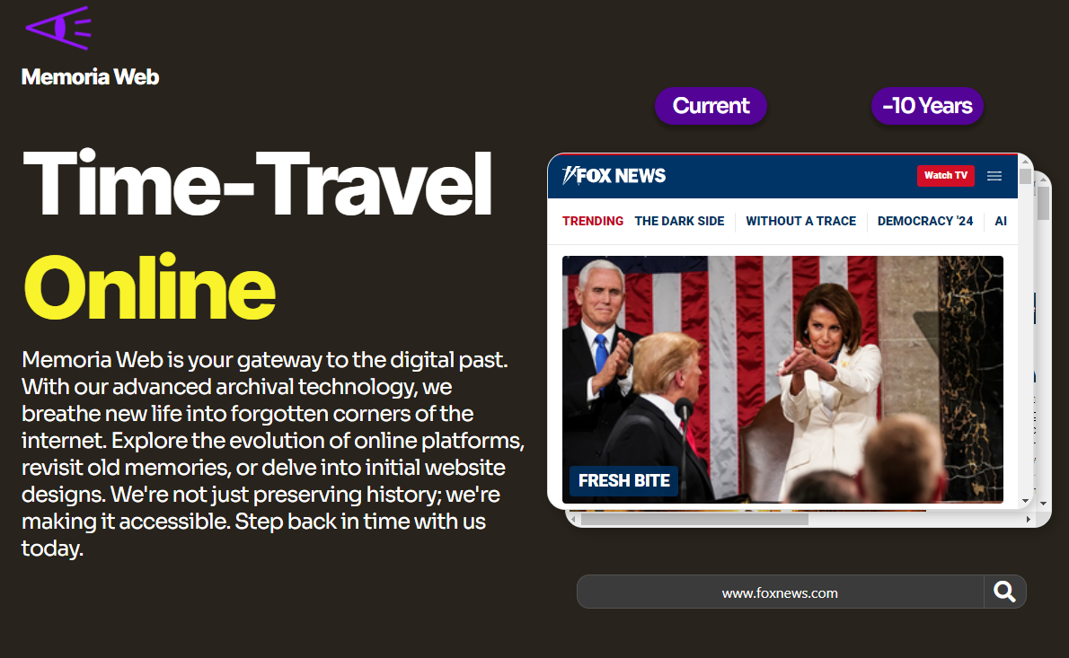
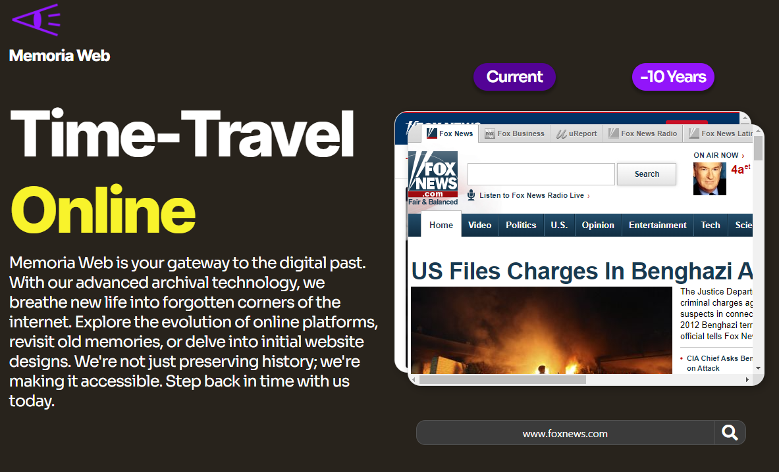
Main Screenshots of the Website's Functions (Cont.)
SEARCH OUTPUT (CURRENT)
SEARCH OUTPUT (Past)

Slide 13
Features
Finished Features
Incomplete Features
Main website with FAQ, Benefits, Recent Websites, sign-in, etc.
The custom search bar utilizes URLs to find specific websites.
Displays past and present websites side-by-side.
Encryption for the password and login for users.
The loading screen for each search does not exceed less than 1 second.
Most complex websites take longer to load in. Did not have the time to resolve this issue.
Some interactive features from the main page had to be scrapped due to time management and debugging issues.
If given more time, most of these issues would be resolved.

Slide 14
Knowledge Gained
The team has gained better knowledge of project scheduling and time management.
Each team member can incorporate what they learned in designing and documenting the website for future projects.
The team also gained insights into the importance of prioritizing essential project functions to ensure a balanced utilization of time and debugging.

Slide 15
Reference links to Project
Group 12's GitHub workspace: https://github.com/BillTheKid2000/Project-Group-12
Memoria Web's Website URL: https://billthekid2000.github.io/Project-Group-12/#

